Slide 1
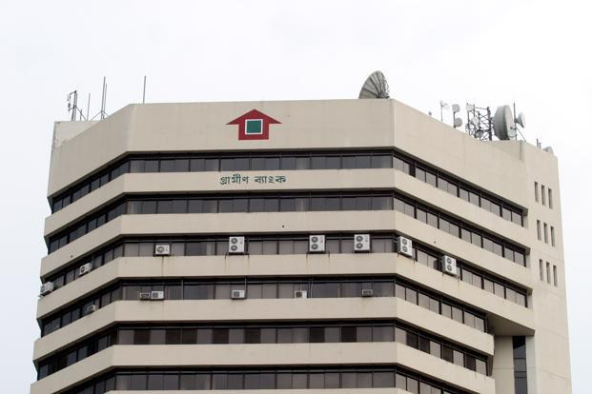
Grameen Bank
SDG 10 Reducing Inequalities
Presented by
Gaukhar Diana

Slide 2




Sustainable development Goals
Net Income
Investors

Slide 3




Case Study Description:
Bangladesh
Ongoing since 1983
Muhammad Yunus (Founder)
Grameen Bank Staff
Government of Bangladesh
International Organizations

Slide 4


challenges
solutions
Challenges
Social and Cultural Barriers
Credit Risk

Slide 5


challenges
solutions
Solutions
Awareness Companies
Develop Credit Scoring Models

Slide 6

Expand Financial Literacy and Education Programs
Recomendations
Invest in Technology and Digital Transformation

Slide 7
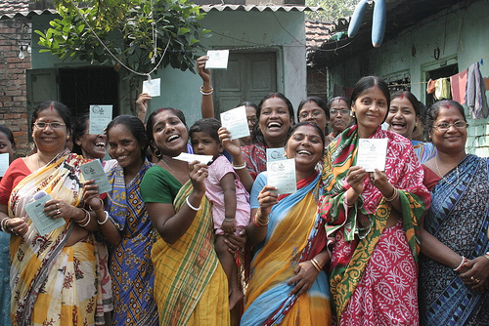

Outcomes and Impact
Women's Empowerment
Reduction of Poverty

Slide 8
Q&A

Slide 9
Would it be applicable in Kazakhstan / Central Asia?
Better user experience and user interface

Slide 10

References
https://grameenbank.org.bd/
http://j469.ascjclass.org/2017/10/12/grameen-bank-empowering-women-through-microfinance-in-bangladesh/
https://forbes.kz/news/2022/03/04/newsid_270920

